Slide 1
Agile SDLC Process
Longview Plan (Tidemark)
Author: Vishal Sangal

Slide 2
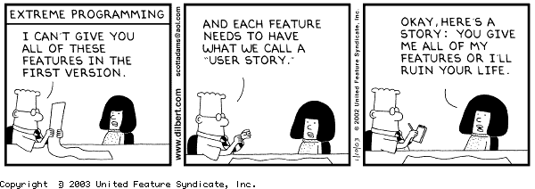
Agile is not this..

Slide 3
Agile Manifesto
Individuals and interactions over processes and tools
Working software over comprehensive documentation
Customer collaboration over contract negotiation
Responding to change over following a plan

Slide 4
Typical Scrum Team
Product Owner – What to build
Development Team – How to build
Scrum Master – How to build it together

Slide 5
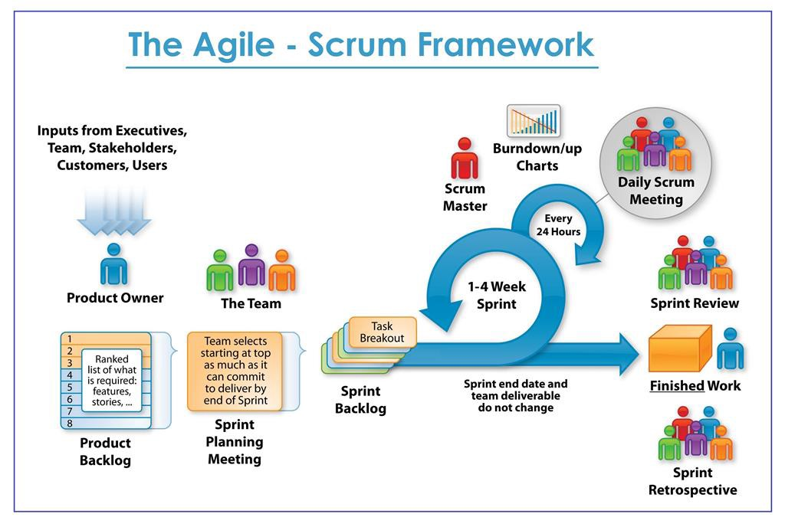
Team(s)
Lohika
San Mateo
A central principle of Scrum is “inspect and adapt.”
Daily Scrum
San Mateo – Mon-Fri
Lohika – Mon - Thur
Sprint Details
Sprint cycle: 3 weeks
Sprint start: Wednesday
Sprint End: Tuesday of 3rd week
Inspect (Sprint review)
End of each sprint
Attended by Stake Holders,PO, entire scrum team
SM sets up a session
DONE Work
Adapt (Sprint retrospective)
End of each sprint
Attended by entire scrum team
SM sets up a session

Slide 6
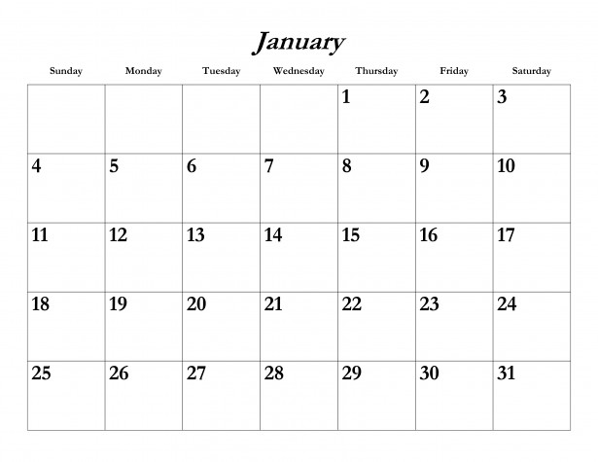
Event Calendar
Next Sprint planning
Sprint n-1
San Mateo standup (M-F)
Sprint n-1
Sprint n
Ukraine standup (M-Thr)
Sprint n
Inspect and Adapt
Sprint n
Sprint n + 2
PO/Eng. Mgr sync up
Sprint n
Sprint n+1

Slide 7


Product Owner
Wayne Stevens
CPO
Scope of Epics smaller to fit within releases (~5 month)
Ensuring that the Product Backlog is prioritized, it is visible and clear to all
Smaller stories to be DONE within the sprint
Increase communication between team and POs
Michael Talbott
VP of Product
Maggie Shen
Product Owner
Nikolas Psomas
Product Owner

Slide 8

Scrum Team(s)
Two Teams
San Mateo
George S (BE)
Oleg M (BE)
Roman D (App)
Tom G (UI)
Peter Y (UI)
Peter White (QE)
Vsevolod R (QE)
Maggie S (PO)
Nikolas P (PO)
Ukraine
Khrystyna H (BE)
Nataliia M (BE)
Andrii V (BE)
Nazar V (UI)
Ihor C (UI)
Rostyslav H (UI)
Yuriy S (QE)
Anastasiia K (QE)
Orest B (QE)
Bohadon (QE)
Accountability; as a team and not an individual
Quality is responsibility to each member
No separate QE team, QE is part of development
Works from sprint backlog and product backlog only
Collaborating work is more important than title
Respect the process - Any change needs to be discussed and refined in retrospective sessions
Self-Organized but not Self-Managed

Slide 9
Scrum Master San Mateo – Vishal Lohika - Nazar
Servant-leadership role
Responsible for promoting and supporting Scrum
Helping everyone understand Scrum theory, practices, rules, and values
Scrum Master Service to the Product Owner
Ensuring that goals, scope, and product domain are understood by everyone on the Scrum Team
Helping the Scrum Team understand the need for clear and concise Product Backlog items
Facilitating Scrum events as requested or needed
Scrum Master Service to the Development Team
Coaching the Development Team in self-organization and cross-functionality
Removing impediments to the Development Team’s progress
Coaching the Development Team in organizational environments in which Scrum is not yet fully adopted and understood.
Scrum Master Service to the Organization
Leading and coaching the organization in its Scrum adoption
Causing change that increases the productivity of the Scrum Team

Slide 10
Epics –
Owned by PO
PO makes sure Epic is achievable within the release cycle
If required, Epic details can be captured in confluence
Design discussion and decision is captured in confluence
Development discussion is captured with Epic in Jira

Slide 11
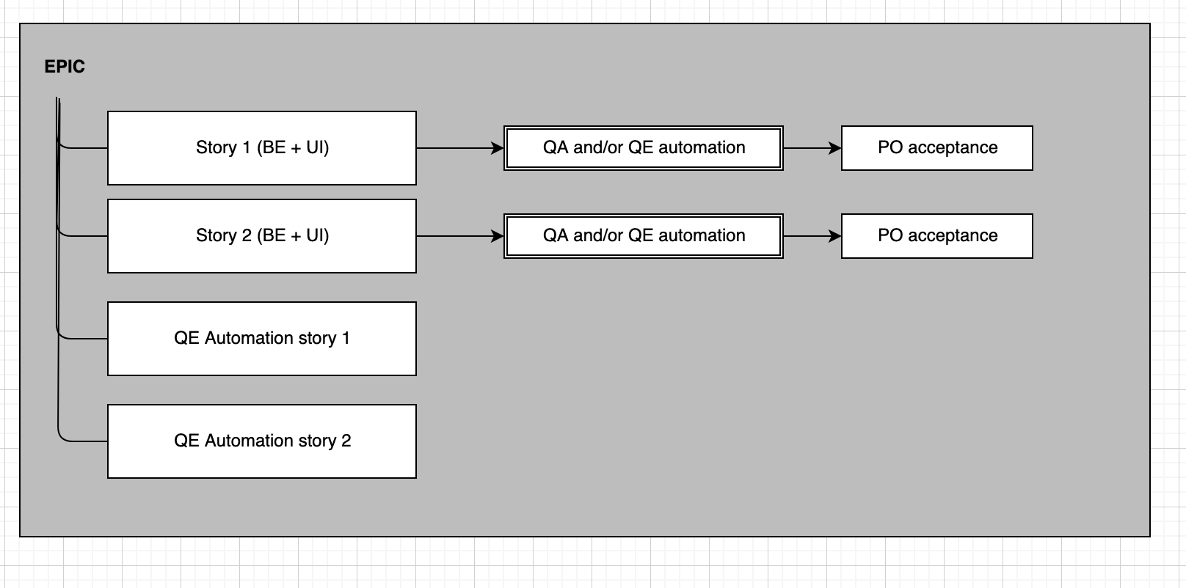
Epic breakdown
For bigger features, PO’s should hold a 'requirements review meeting' to help the team prepare for story grooming (allow engineering to start thinking about the approach, estimates and story breakdown).
Initially, stories will include all aspects (UI, BE, Engine, QE)
Each story must include testing (manual at a minimum). If the effort to create automated tests is too large to fit into the story (scoped for one sprint), then separate stories can be created for automated testing, parented to epic
QE can move the story to PO accepted state after the manual test
Epic will be accepted only after all QE automation stories are completed
If a story is too big for a sprint, first seek to break it down into smaller functional stories. Only consider breaking it out by components or tasks as the last resort.
Stories are owned and agreed upon by the entire scrum team. PO’s start the process by creating a ‘strawman’ of granular functional stories. Scrum team needs to refine these to provide the appropriate level of content and structure (either grouping where applicable or splitting into more detail). It's a 2-way street. This happens during backlog grooming. Backlog grooming includes both story composition as well as estimates.

Slide 12
Story -
Short – scoped within a sprint
Should have AC (Acceptance criteria)
Should be functional in nature and follow (INVEST)
QE tasks should be part of story completion
*Independent * Negotiable *Valuable *Estimatable *Small *Testable

Slide 13
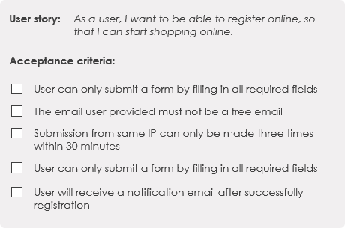
Story - Acceptance Criteria
Sample format
User Story
As a <who>, I <what> so that <why>
Job Story
When <situation> I want to …..so I can……
Format does not matter as long as we have clear acceptance criteria
Sample AC

Slide 14
Story - DOD (Definition of Done)
Code review done
All defects against the story are completed
Unit tests are completed
Automation tests adjust - if small enough
Manual test done, if required
* This may change as we mature our process

Slide 15
Definition of Done
Story
Code review completed
Unit tests are completed
All defects against the story are completed
Automation tests adjusted - in small enough
Manual test completed - if required
Defect
Code review is completed
Unit tests are adjusted if required
Automation tests are adjusted if required

Slide 16
What if(s)..
Story is not completed at the end of Sprint
It will be evaluated during sprint planning to see if it’s a candidate for splitting or completely moving to next sprint by adjusting story points.
Development is done but testing is not
This is considered a gap in evaluation and estimation. This will be discussed in Retrospective to understand what we could have done better.

Slide 17
Release time
Options | PST | EST | EMEA
(EMEA) (US) | 3 pm – 5 pm (fri) | 6 pm – 8 pm (fri) | 12:00 am - 3:00 am (sat)
(US) (EMEA)
(US) (EMEA)

